Slide 1
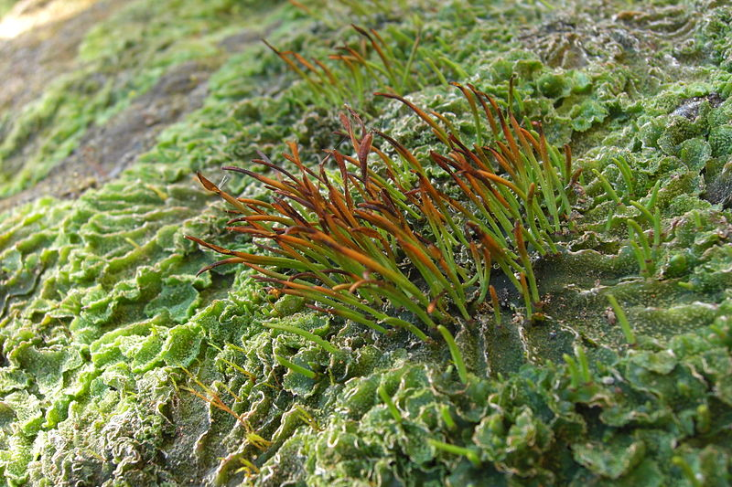
Sex Machine
Jason Hollinger / CC BY (https://creativecommons.org/licenses/by/2.0)

Slide 2
Primitive Algae
Cyanobacteria
Chlorophyll a
Phycobillisomes
Protoalga
Viridiplantae
(Green Algae;
Plants)
Rhodophyta
(Red Algae)
Glaucophyta
Chlorophyll a
Phycobillisomes
Chloroplast has wall
Chlorophyll a
Phycobillisomes
Chlorophyll a
Chlorophyll b

Slide 4
Seaweed Sex
Jason Hollinger / CC BY (https://creativecommons.org/licenses/by/2.0)

Slide 5
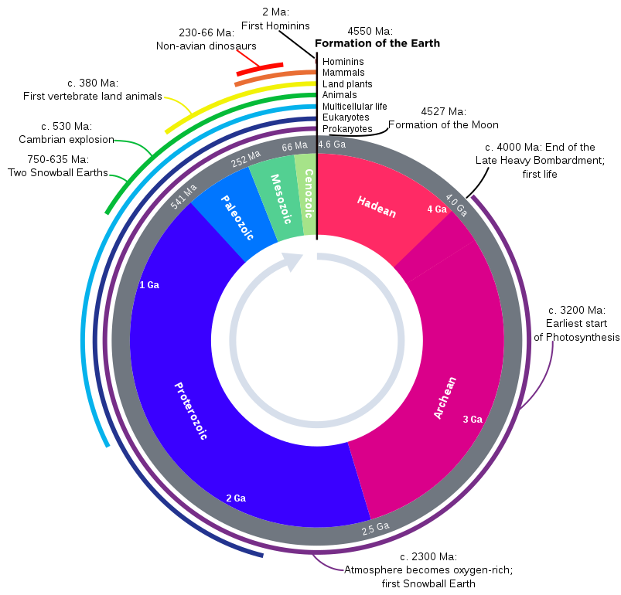
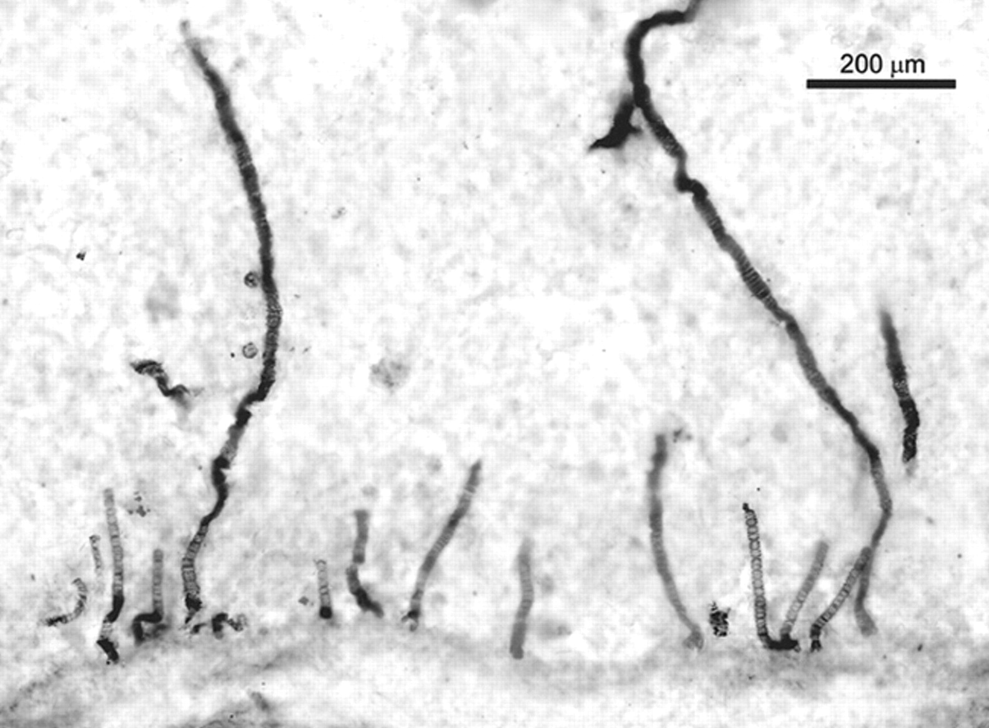
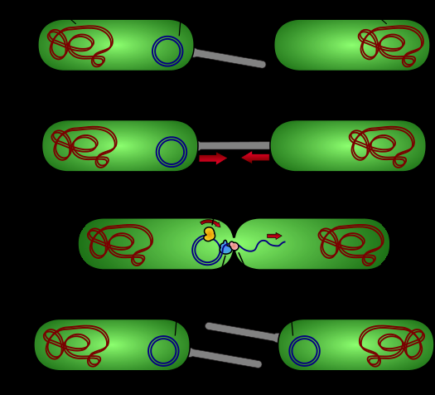
…even Eukaryotic protists do it
~1.2Ga
Earliest evidence for Eukaryotic sexual reproduction
Bangiomorpha pubescens
Red alga, first fossil evidence of sexual reproduction
Bacteria “Sex” – exchange of DNA between cells

Slide 6
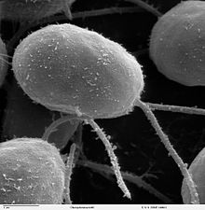
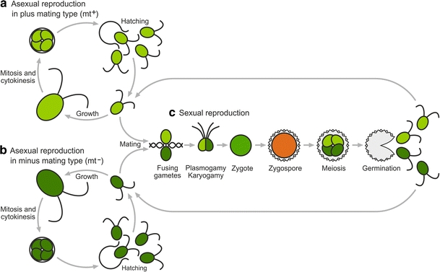
Chlamydomonas reinhardtii
Green alga
Lives in fresh water and on soil
Haploid most of the time
Mitosis gives 4 daughter cells
Sexual reproduction when stressed
Gametophytes in 2 mating types
mt+ and mt- (genetically set)
Persistent Zygospore – diploid, inactive, survives stress

Slide 7
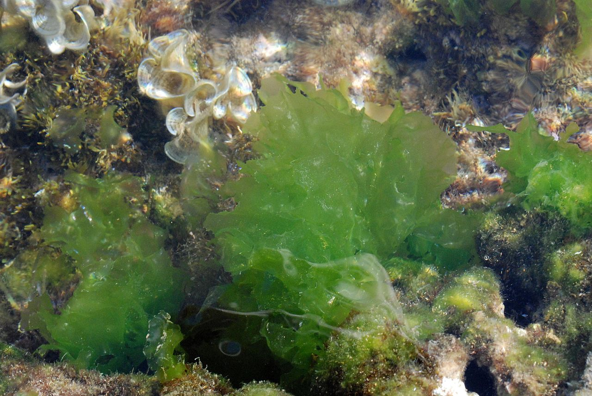
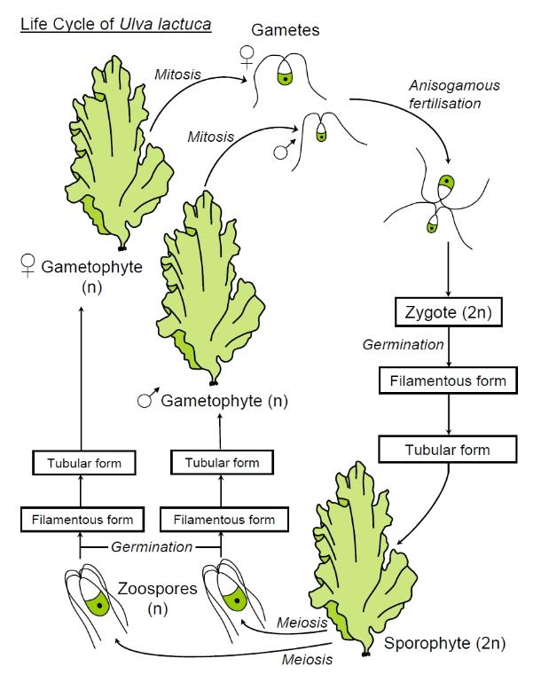
Ulva lactuca – Sea Lettuce
By Tigerente - Own work, CC BY-SA 3.0, https://commons.wikimedia.org/w/index.php?curid=10619077
Gametophyte (haploid; n) and sporophyte (diploid; 2n) both persist and grow as “seaweed”
Alternation of generations
More about Ulva: https://doi.org/10.3389/fpls.2015.00072

Slide 8
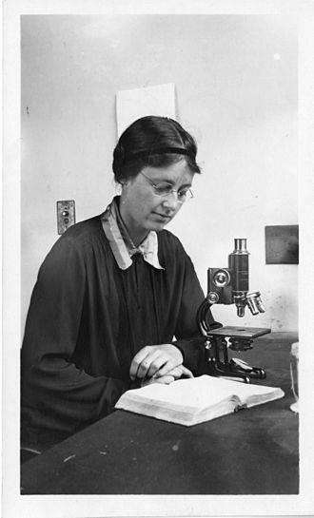
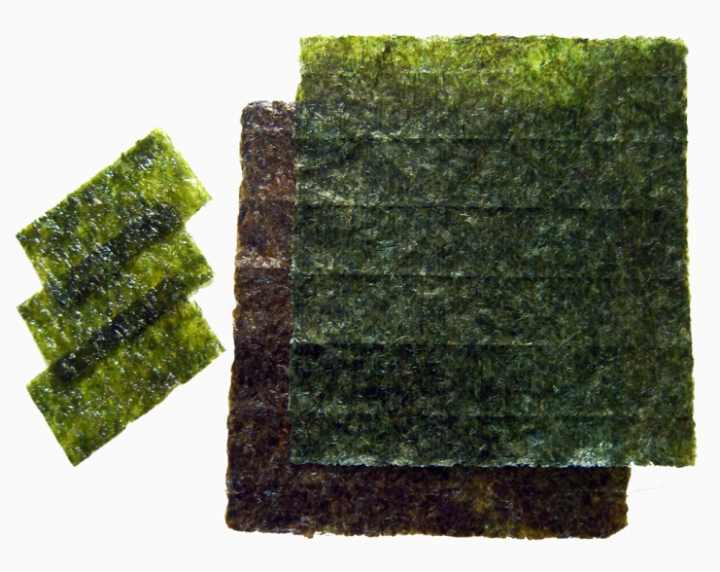
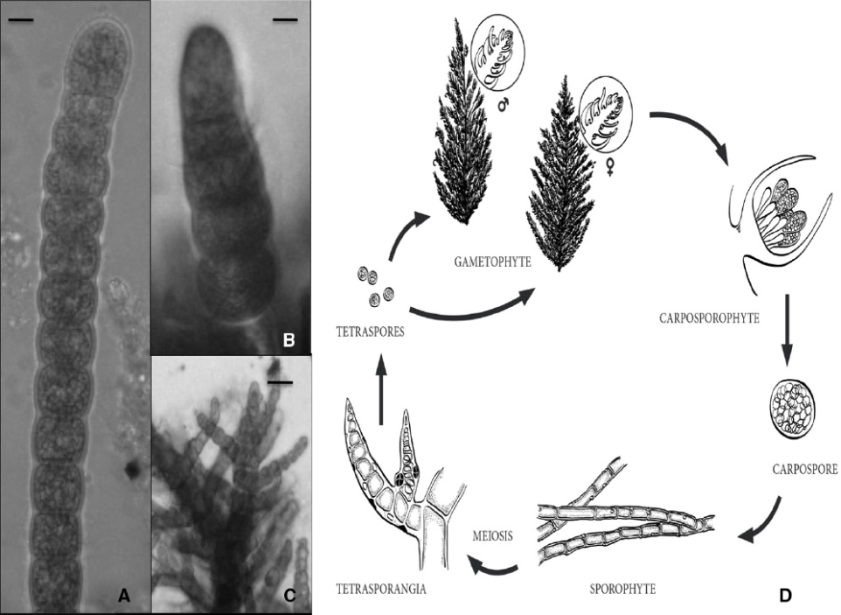
Sushi Sex – red algae
Sushi made of Nori – red alga, Porphyra sp.
Gametophyte – plate like; used for sushi
Sporophyte – filament
Shows alternation of generations
Distinct male and female structures
but non motile sperm (requires currents)
Kathleen Drew – the Mother of the Sea
14th April – Drew Festival
See: https://en.wikipedia.org/wiki/Kathleen_Mary_Drew-Baker
For more read: http://journal.frontiersin.org/article/10.3389/fpls.2015.00093/full

Slide 10


David Attenborough and the move to land
https://learningonscreen.ac.uk/ondemand/index.php/clip/101274
(6 mins)
“The First Forests”; full episode: https://learningonscreen.ac.uk/ondemand/index.php/prog/00016696?bcast=105732528

Slide 12
Land Ahoy
Jason Hollinger / CC BY (https://creativecommons.org/licenses/by/2.0)

Slide 13
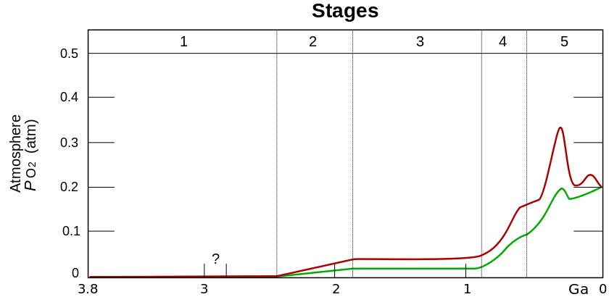
The first land plants
Plants colonised land ~500 MYa ago
Coincided with (followed? caused?) increased O₂ in atmosphere
Followed on from the Cambrian Explosion
(caused by algae? See: http://www.bbc.co.uk/news/science-environment-40948972)
Advantages:
New space; Higher CO₂
Disadvantages:
Lack of water; Reproduction

Slide 14
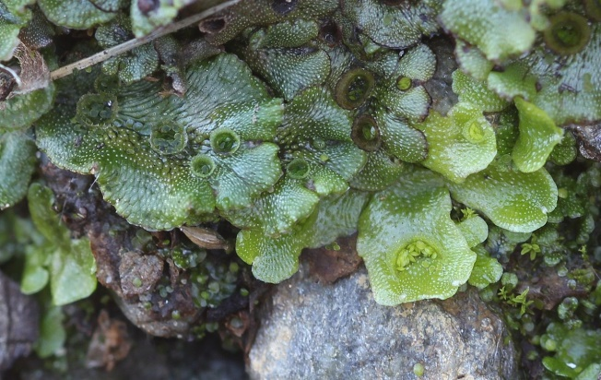
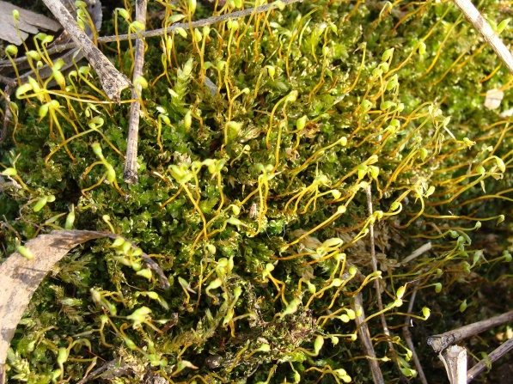

The Bryophytes
Liverworts
Mosses
Hornworts
By Avenue - Own work, GFDL, https://commons.wikimedia.org/w/index.php?curid=14927536
By Rippey574 at English Wikipedia, CC BY 3.0, https://commons.wikimedia.org/w/index.php?curid=53304226
By Jason Hollinger - CC BY 2.0, https://commons.wikimedia.org/w/index.php?curid=24215929
n.b. This is controversial
Vascular Plants

Slide 15
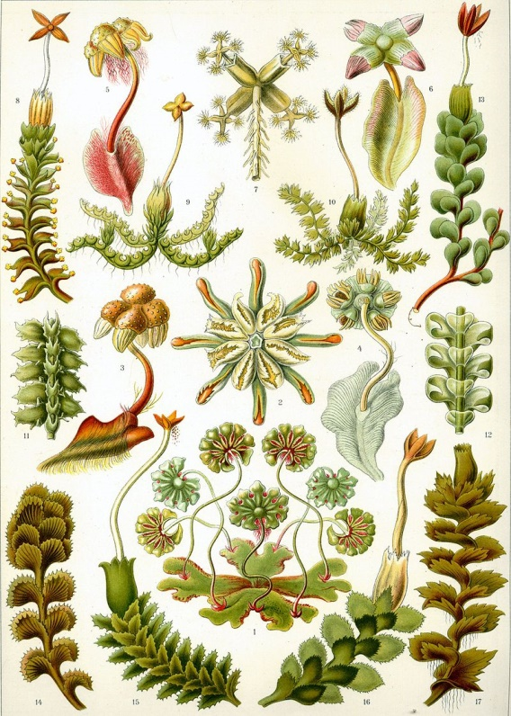
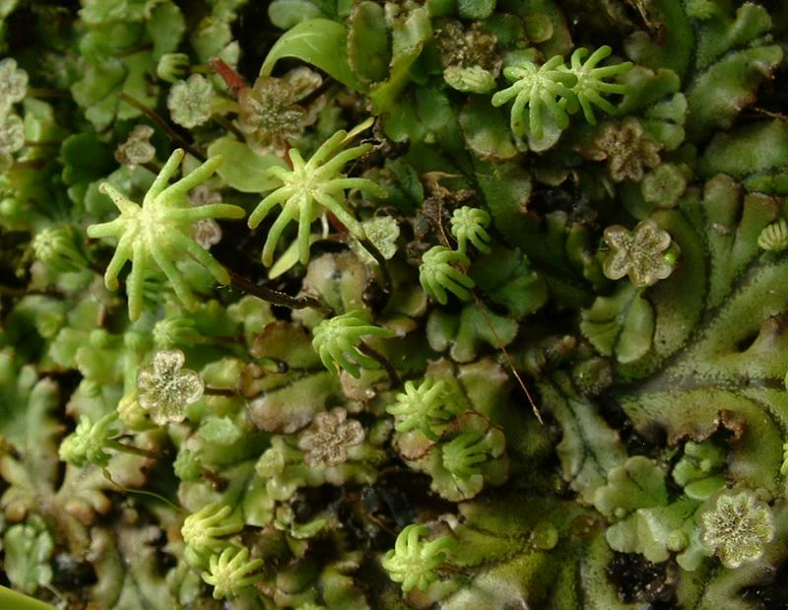
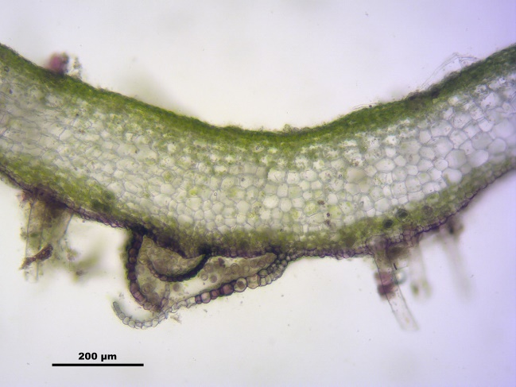
Liverworts
Marchantia polymorpha
By J.F Gaffard CC BY-SA 3.0, https://commons.wikimedia.org/w/index.php?curid=1666055
Dominant gametophyte - may grows as a plate -thalloid
Or may be “leafy”
Specialised cells, not all photosynthetic
Rhizoids grow down and absorb water
Primitive water transport
Gametophores grow up – male vs female
Sperm swim from male gametophores (from antheridia) to female ones (to archegonia)
Sporophyte grows on gametophore

Slide 16
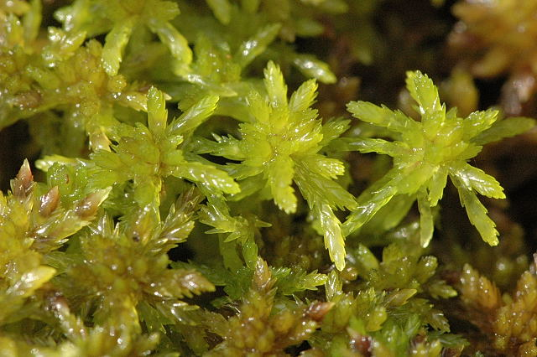
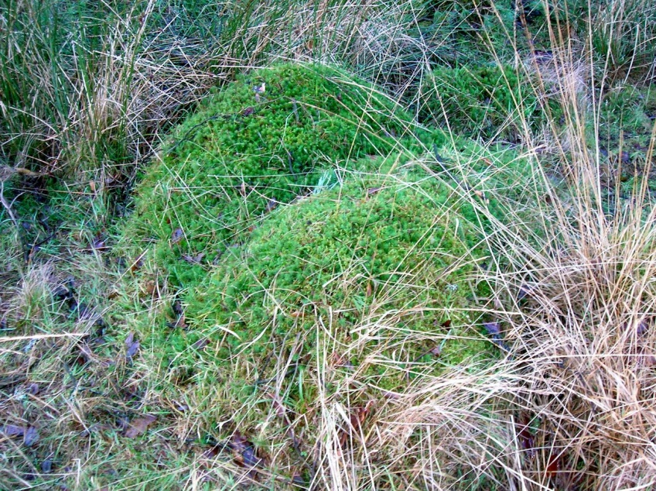
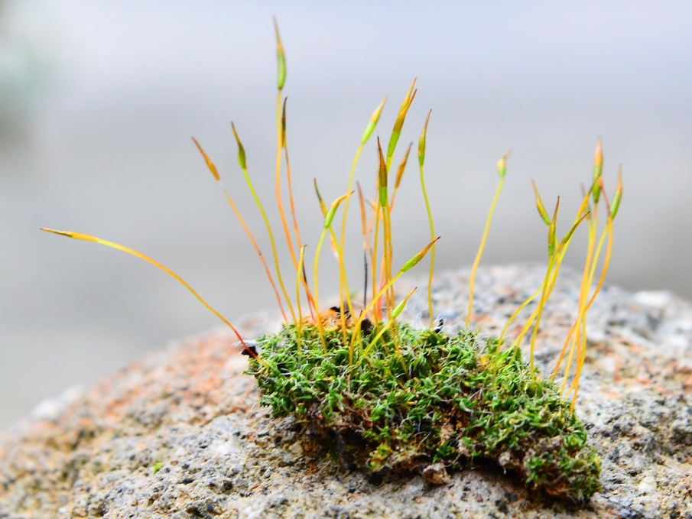
Moss
More complex structure
“Leaves” arranged in spirals
May have extensive branching
Simple water conducting tissues
Maybe ombrotrophic
(nutrients from rain water)…
…so mat forming
Sporophyte grows well above gametophyte
Sphagnum flexuosum
By James Lindsey at Ecology of Commanster, CC BY-SA 3.0, https://commons.wikimedia.org/w/index.php?curid=1718182
Sphagnum hummocks
By Rosser1954 (Own work) [CC BY-SA 3.0 (http://creativecommons.org/licenses/by-sa/3.0)], via Wikimedia Commons
By Bob Blaylock - Own work, CC BY-SA 4.0, https://commons.wikimedia.org/w/index.php?curid=38212443

Slide 17
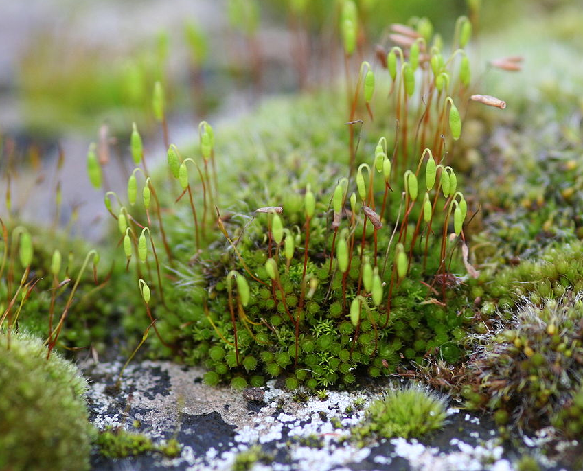
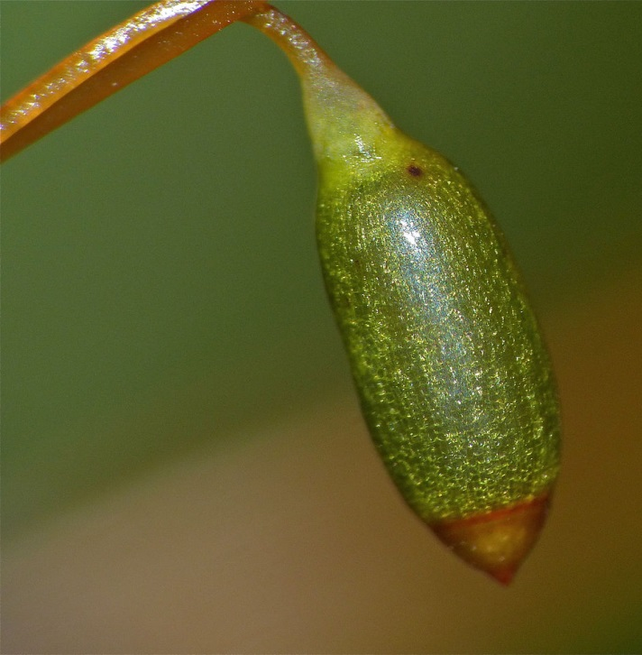
Moss sporophytes
Key innovations:
Cuticle (waterproof)
Vascular tissue
Stomata
Controlled desiccation
CC BY 2.0, https://commons.wikimedia.org/w/index.php?curid=671648
Tall sporophytes = better spore dispersal?
By Bernard DUPONT from FRANCE - Mnium hornum capsule of a sporophyte,
CC BY-SA 2.0, https://commons.wikimedia.org/w/index.php?curid=40726572

Slide 18
Hornworts
Gametophyte - thalloid
Sporophyte – similar features to moss
May have blue green appearance…
due to presence of cyanobacteria in clefts (espec. Nostoc sp.)
Symbiosis with Nitrogen fixer

